Slide 1
Introduction into MCMC
13.11.23

Slide 2


Slide 3




Insights into the STADS Datathon Fall 2023
Thank you for your participation!
Spoiler Alert: The next Datathon will take place on May 02 and 03, 2024.
Datathon Review Session – 05.11.2023
Introduction to MCMC - 13.11.23

Slide 4
Introduction into Markov Chain Monte Carlo

Slide 5
What is MCMC made of?
MCMC is a powerful method enabling the generation of realistic samples from complex probability distributions, making it crucial in diverse applications within the field of data science.
GOAL:
Generating samples from high-dimensional probability distributions.
Monte Carlo Simulation
Markov Chains
Recursive generation of a sequence of random variables (X_{t})_{t∈N}.
X_{t+1} depends only on X_{t}, not on previous variables.
Markov chain has an invariant distribution π
Utilizes independent random numbers for process simulation and approximate solution finding
Applications of MCMC
Estimation of complex probability distributions.
Used in Bayesian statistics, machine learning, Bayesian networks, finance, and various other fields.
Introduction to MCMC - 13.11.23​

Slide 6
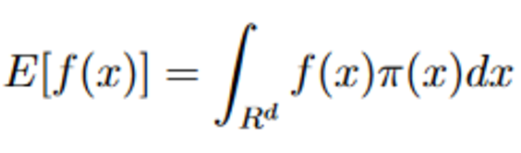



An Example for Understanding the Problem
Compute integrals of the form
where f(x) is a (nice) function, and π(x) is a density function (e.g., a non-negative function)
Monte Carlo Idea:
Generate random numbers.
Calculate the sample mean using the formula.
Convergence according to the Law of Large Numbers.
Problem:
Analytical solutions often do not exist, and deterministic rules can be slow in high dimensions, necessitating a new approach.
Solution: Markov Chain Monte Carlo (MCMC)
Generate samples from a Markov chain with an invariant distribution π.
Samples converge to the desired distribution according to the Law of
Large Numbers.
Introduction to MCMC - 13.11.23​

Slide 7
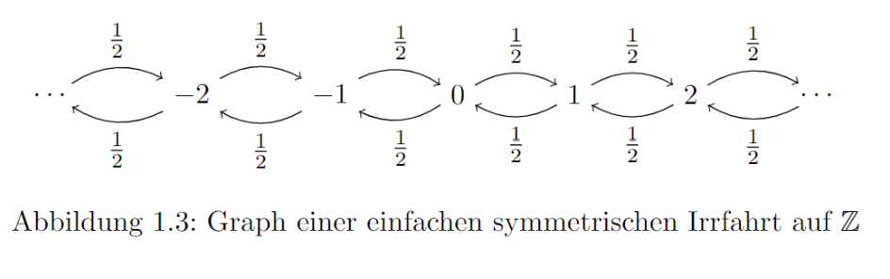
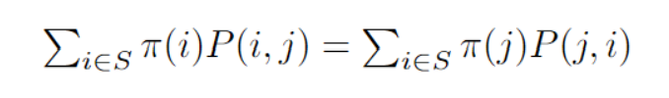
General Aspects of Markov Chains in MCMC
Markov Chain:
Probability of x{n+1} depends only on x{n} and not on history x{0}, …, x{n-1}
Irreducibility:
A Markov Chain is said to be irreducible if, for any pairs {x} and {y} a transition between them is possible with a finite number of steps
Aperiodicity:
Start from {x} and come back to the same {x} after n steps. There are many possible values for n. The greatest commo divisor of all of them (ggT) is
called period. A Markov Chain is aperiodic if it hast period = 1.
Detailed Balance Condition:​
P(i,j) is the transition probability from state i to state j. The left side of the equation represents the flow from state i to state j, while the right side represents the reverse flow, ensuring a balance in the long run.
Introduction to MCMC - 13.11.23​

Slide 8
Metropolis-Hasting Algorithm
Algorithm
(0) Initialise:
Initialize x₀ somewhere, e.g., set x₀ = 1
(i) Propose:
Propose a new point x̂, where x̂ is normally distributed with N(x_{n-1},10)
(ii) Compare:
Calculate α = min(1, π(x̂)/ π(x_{n-1}))
("Which point is more likely according to our distribution?")
(iii) Accept or Reject:
With probability α set x_{n} = x̂ (or if π(x̂)/ π(x_{n-1}) > 1), otherwise x_{n} = x_{n-1}
(iv) Repeat (i) – (iii) n times to generate samples x₁,…, x_{n}
Exploration: The algorithm explores the space of possible points by occasionally accepting less probable points, allowing it to discover new regions of the distribution
vs.
Exploitation:
It exploits known high-probability regions by usually accepting more probable points, converging towards the areas with higher density
Introduction to MCMC - 13.11.23​

Slide 9
Overview of the further development of MCMC algorithms
 | Metropolis Hastings (MH) | Metropolis Adjusted Langevin Algorithm (MALA) | Hamiltonian Monte Carlo (HMC) | No U-Turn Samples (NUTS)
Goal | generate samples from a probability distribution π
needed | Initial sample x₀ Probability distribution π | Initial sample x₀ Probability distribution π Gradient of log(π) | Initial sample x₀ Probability distribution π Gradient of log(π) | Initial sample x₀ Probability distribution π Gradient of log(π)
Idea | Suggest new sample randomly close to the previous sample and compare how likely it is compared to the previous sample | Like MH, but suggest new sample in the direction of the density gradient for higher acceptance probability | Like MALA, but move further in the direction of the gradient | Like HMC, take further steps until the new proposal is closer to the starting point than the previous point
Hyperparameter | Proposal Density G | Stepsize ɛ | Stepsize ɛ number of steps L | Stepsize ɛ
When to use | Simple distributions | More complex distributions | Complex distributions | complex distributions
Comutational Effort | Low | Medium | High | High
Introduction to MCMC - 13.11.23​

Slide 10
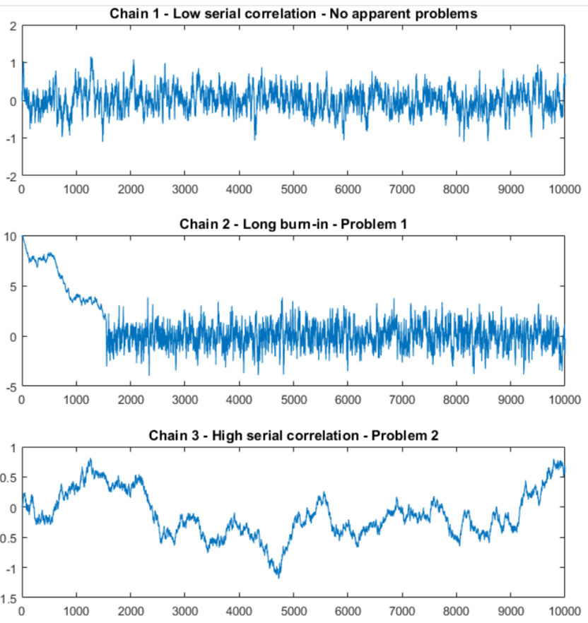
Chosing the right MCMC algorithm
Selecting the most suitable Monte Carlo (MC) sampler depends on the characteristics of your problem. While there's no one-size-fits-all algorithm, NUTS (No-U-Turn Sampler) and MALA (Metropolis-Adjusted Langevin Algorithm) often perform well across diverse problem domains.
Effective Sample Size (ESS)
Traceplots
Visual inspection helps assess convergence, mixing, and overall behavior of the Markov Chain
How many iid samples are your generated samples equivalent to?
Higher ESS indicates better performance
Considerations for Better Performance:
Hyperparameter Tuning:
Adjust parameters like step size, tuning parameters, or mass matrix to optimize sampler performance.
Initialization:
Proper initialization of the chain is crucial for efficient exploration of the parameter space.
Burn-in:
Allow for a burn-in period to discard initial samples, ensuring the chain reaches a representative state.
Introduction to MCMC - 13.11.23​

Slide 11
Thank you for your attention!
6. STADS Session – 30.10.2023
Introduction to MCMC - 13.11.23

